Slide 1
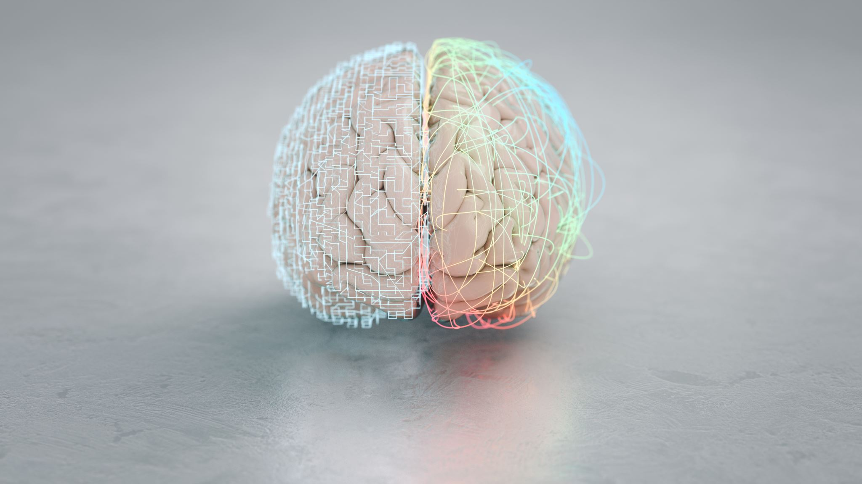

ScanSmart AI: Intelligent Brain Tumor Classification
Affiliation:
Lambton College, Mississauga, ON

Slide 2
Team Members & Responsibilities
Venkata Manish Katragadda - Project Lead, responsible for overseeing the project and ensuring milestones are met.
Varun Kashyab - Data Specialist, in charge of data collection and preprocessing.
Likitha Jayanthi & Mahima Akula - Machine Learning Engineers, focuses on model development and training.
Jyothirmai Veeranki & Ajomon Jose - Validation and Testing Coordinators, handles model validation and performance evaluation.

Slide 3

Introduction - Problem Statement
Background:
Brain tumors pose serious health risks; early and accurate detection is crucial.
MRI is a key diagnostic tool, but manual interpretation is time-consuming and complex.
Problem Statement:
Accurate classification of brain tumors from MRI images is challenging due to subtle differences and high-dimensional data.
Existing machine learning models struggle with class imbalance and the need for large annotated datasets.

Slide 4
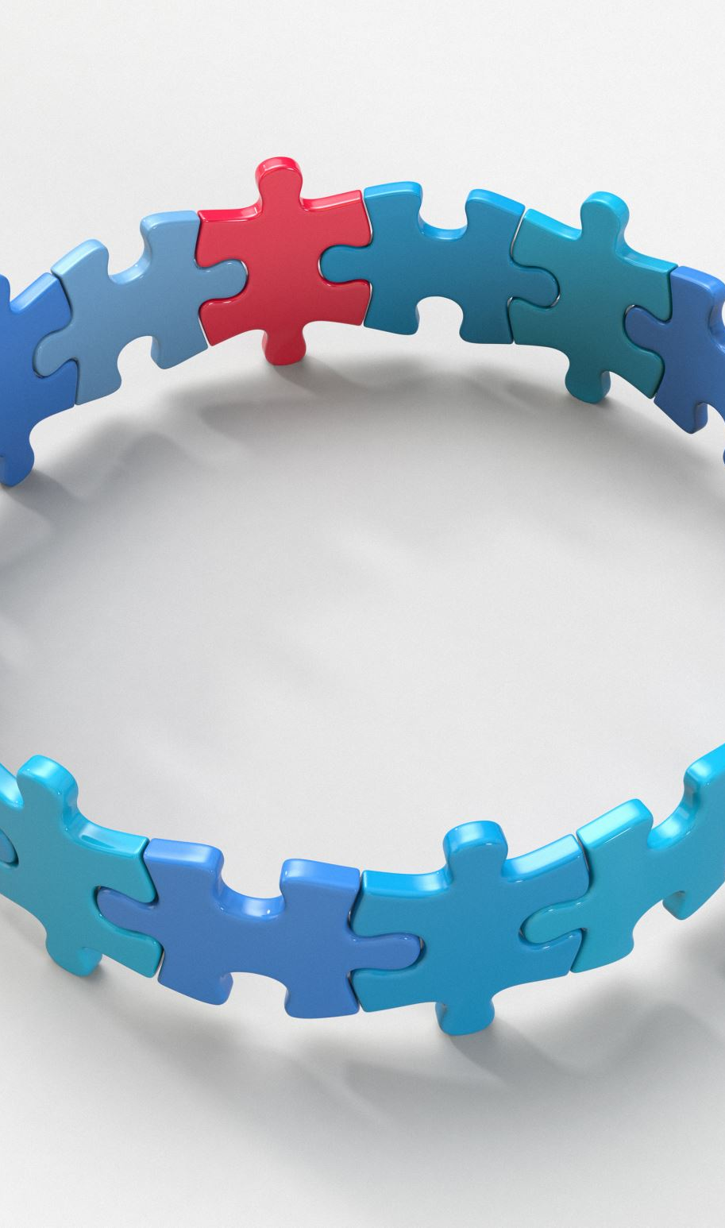
Objectives
Develop and fine-tune machine learning models for accurate brain tumor classification.
Build an ensemble model to improve classification accuracy.
Create a user-friendly web application for real-time tumor classification.
Ensure the models are interpretable for better trust and adoption in clinical settings.

Slide 5

Significance and Relevance
Industry Impact: Improving document classification systems is not just about efficiency; it's about transforming business operations, ensuring compliance, and enhancing access to critical information.
Technological Leap: By adopting CNNs, ScanSmart AI sets a new standard for reliability and scalability in document management automation.

Slide 6

Overview of the Project
Methodology:
Data Collection: Gathered MRI images, preprocessing for consistency and quality.
Model Development: Used transfer learning on pre-trained models, fine-tuned for brain tumor classification.
Evaluation: Assessed model performance using accuracy and other metrics.
Application Development: Built a Flask-based web app for real-time image classification.

Slide 7

Data Collection
Data Sources:
MRI images sourced from a public dataset on Kaggle.
Four classes: Glioma, Meningioma, No Tumor, Pituitary Tumor.
Data Details:
Total of 3,264 images, with balanced representation across classes.
Images provided in PNG format, varied in size before preprocessing.

Slide 8
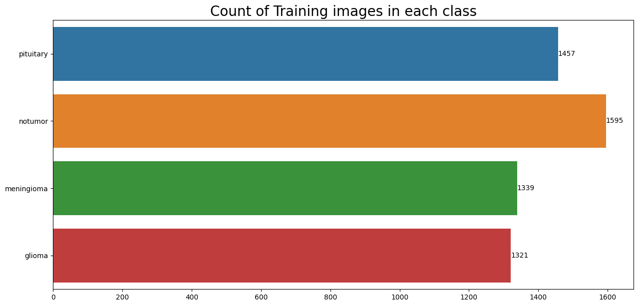

Slide 9
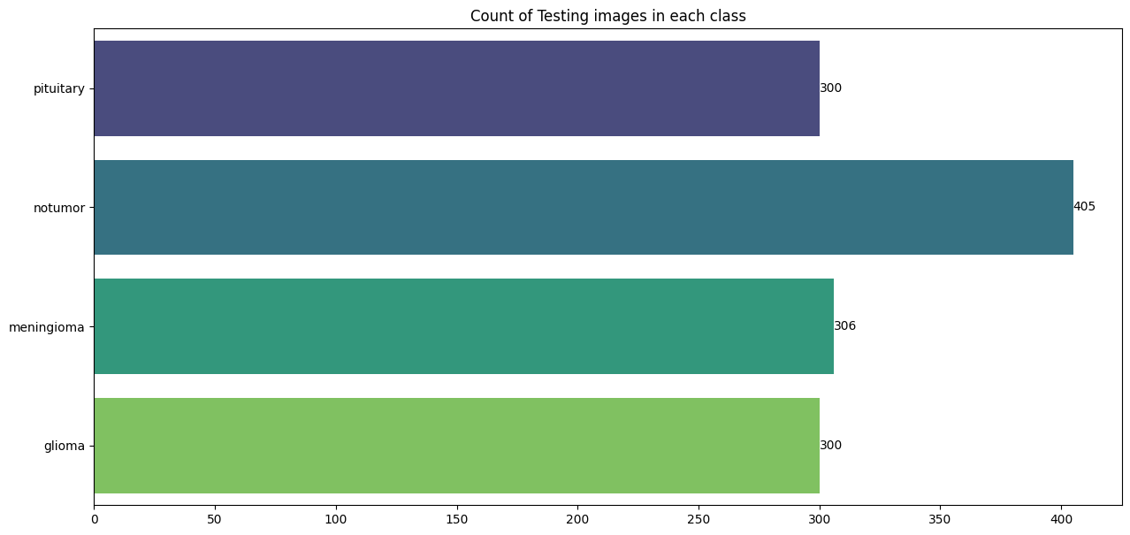

Slide 10
Data Preprocessing
Resizing and Normalization:
Standardized image size to 224x224 pixels to fit model input requirements.
Normalized pixel values to a range of [0, 1] for faster model convergence.
Data Augmentation:
Applied techniques like rotation, zoom, and flipping to enhance the dataset size and diversity.
Aimed to improve model generalization by simulating various scenarios.
Challenges Addressed:
Managed class imbalance and variability in image quality through selective augmentation and preprocessing.

Slide 11
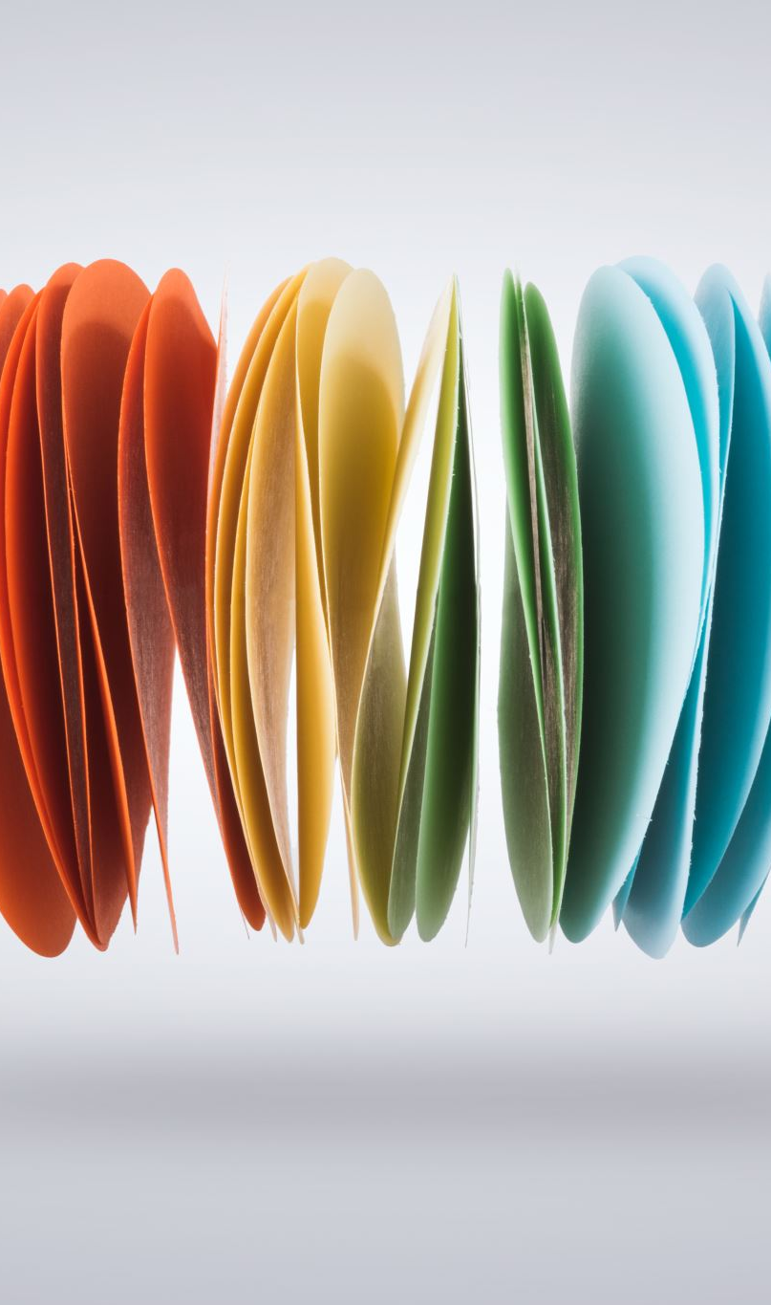
Model Selection
VGG16: Known for deep layers and capturing complex image features.
InceptionV3: Efficiently handles multi-scale features.
EfficientNetB0: Balances depth, width, and resolution for optimal performance.
Rationale: Selected these models based on their proven track records in image classification tasks, particularly in medical imaging.

Slide 12
Transfer Learning and Fine-Tuning
Transfer Learning:
Utilized pre-trained models (VGG16, InceptionV3, EfficientNetB0) originally trained on ImageNet.
Adapted these models to the specific task of brain tumor classification by replacing the final layers.
Fine-Tuning:
Further training was done on the MRI dataset, adjusting the model weights to improve accuracy.
Unfrozen some deeper layers to allow the model to learn more specific features of brain tumors.

Slide 13
Hyperparameter Tuning
Methods: Employed Keras Tuner with Random Search to find the best combination of hyperparameters.
Key Hyperparameters: Tuned parameters included learning rate, dropout rate, and the number of dense units in the fully connected layers.
Outcome: Achieved improved model performance by optimizing these parameters, leading to better accuracy and generalization.

Slide 14
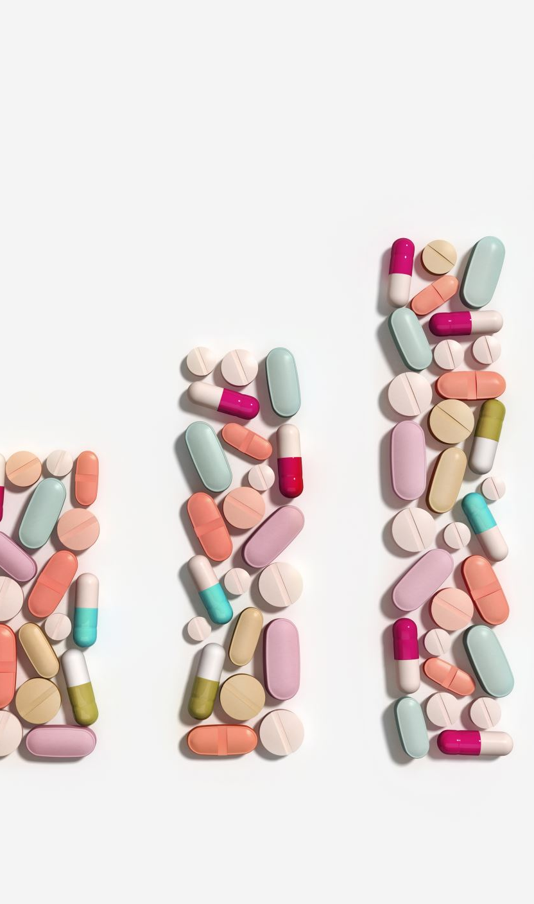
Ensemble Learning
Approach:
Created an ensemble by averaging the predictions from the three models (VGG16, InceptionV3, EfficientNetB0).
Benefits:
The ensemble model demonstrated higher accuracy compared to individual models.
Reduced misclassification rates and provided more robust predictions across all tumor classes.

Slide 15
Model Training and Evaluation
Training Procedure:
Fine-tuned each model with the preprocessed MRI dataset.
Applied real-time data augmentation during training to improve model generalization.
Validation and Testing:
Used an 80/20 split for training and validation.
Evaluated model performance on a separate test set to ensure unbiased results.
Performance Metrics:
Assessed models using accuracy, precision, recall, F1-score, and confusion matrices.
Compared individual models and ensemble performance.

Slide 16
Results - Model Performance
VGG16 Performance:
Accuracy: Achieved moderate accuracy, struggled with subtle differences between tumor types.
Strengths: Effective in basic classification tasks.
Weaknesses: Difficulty distinguishing between glioma and meningioma.
InceptionV3 Performance:
Accuracy: Higher accuracy compared to VGG16, better at capturing complex features.
Strengths: Strong performance in distinguishing non-tumor from tumor images.
Weaknesses: Some misclassifications in more complex tumor types.
EfficientNetB0 Performance:
Accuracy: Achieved the lowest accuracy among individual models.
Strengths: Highest Performance for no tumor class.
Weaknesses: Some overfitting observed during early epochs.

Slide 17
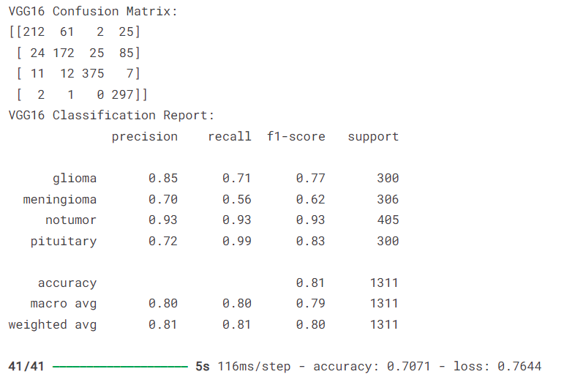

Slide 18
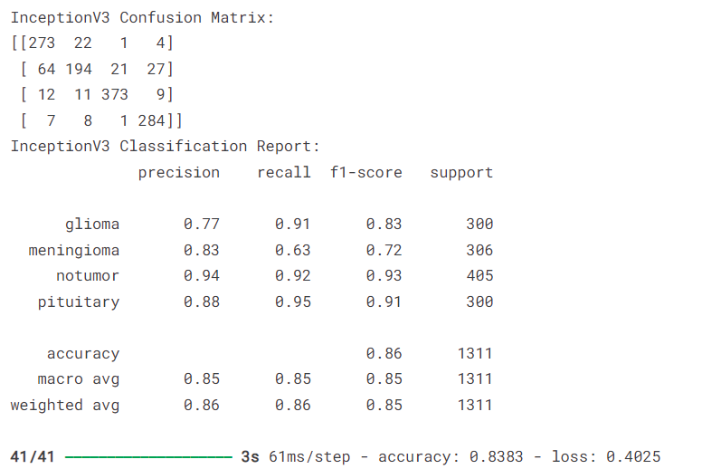

Slide 19
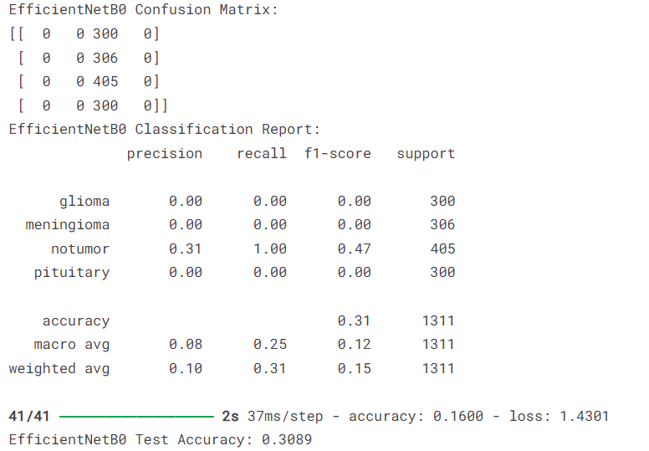

Slide 20

Ensemble Model Performance
Overall Accuracy:
The ensemble model achieved superior accuracy, outperforming individual models.
Reduced misclassification errors and provided more consistent results.
Key Metrics:
Highest precision, recall, and F1-scores across most classes.
The ensemble model effectively leveraged the strengths of each individual model.

Slide 21
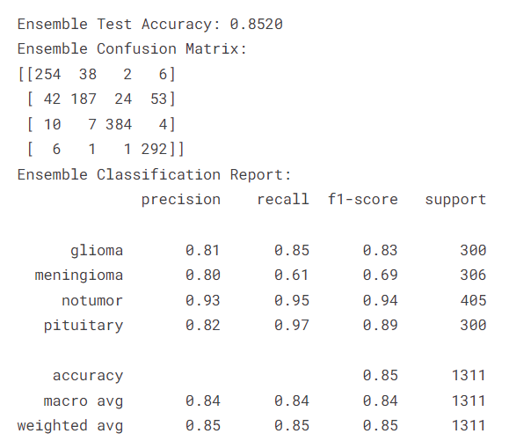

Slide 22
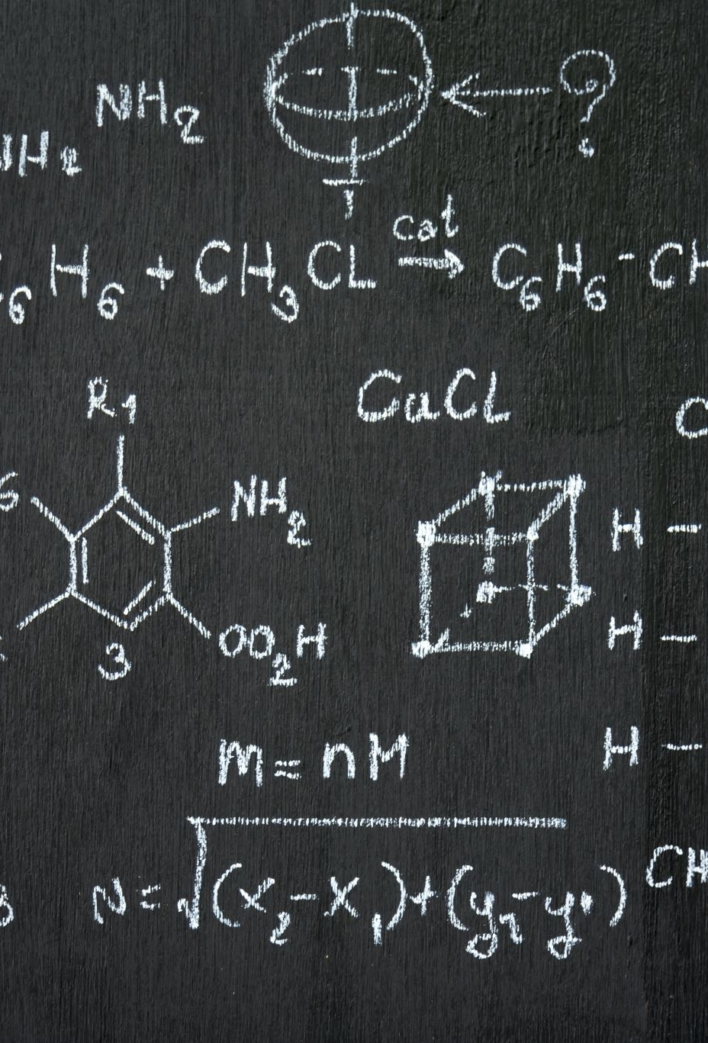
Visualization of Results
Confusion Matrices:
Display confusion matrices for the ensemble model.
Highlight how the ensemble model reduces misclassifications compared to individual models.

Slide 23
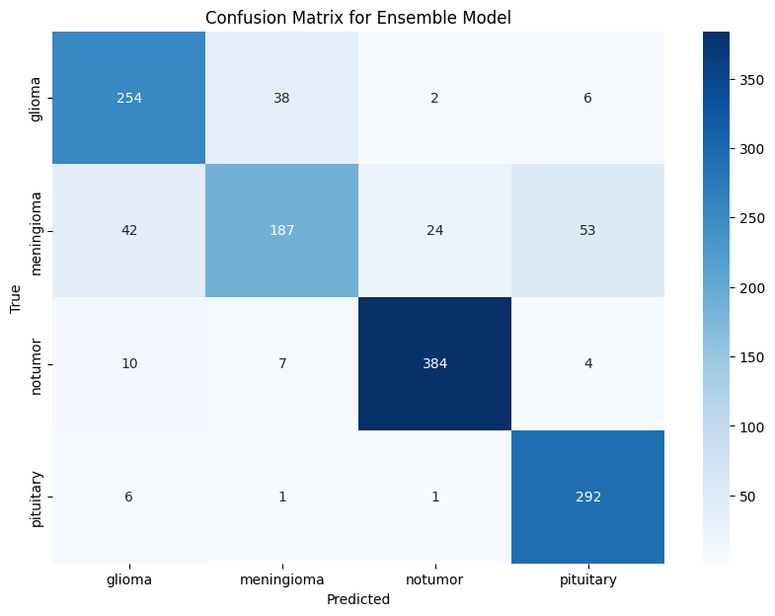

Slide 24
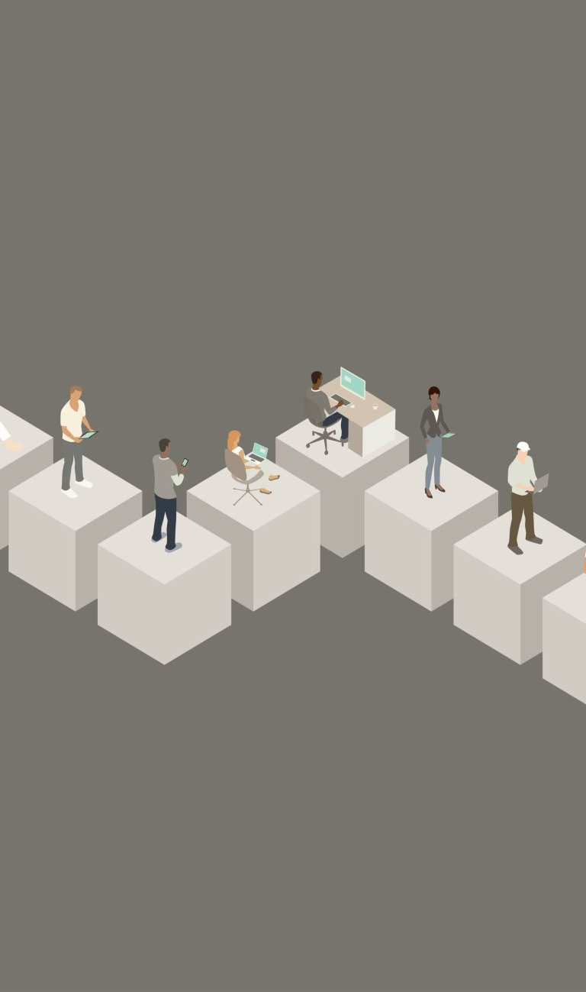
Discussion
Interpretation of Results:
The ensemble model demonstrates significant improvements in accuracy and robustness.
The combination of different model architectures led to better generalization.
Strengths and Weaknesses:
Strengths: High accuracy, better handling of class imbalances, and robust performance across varied tumor types.
Weaknesses: Some models showed overfitting, and there were occasional challenges in differentiating between similar tumor types.

Slide 25
Challenges and Solutions
Memory Management:
Challenge: High memory usage during model training.
Solution: Simplified approach with fewer trials and use of temporary directories for intermediate storage.
Model Interpretability:
Challenge: Ensuring model predictions are interpretable and trustworthy.
Solution: Integrated SHAP (SHapley Additive exPlanations) to explain model decisions, though required adjustments for TensorFlow.
Class Imbalance:
Challenge: Slight variations in the number of images per class.
Solution: Applied selective data augmentation to underrepresented classes.

Slide 26
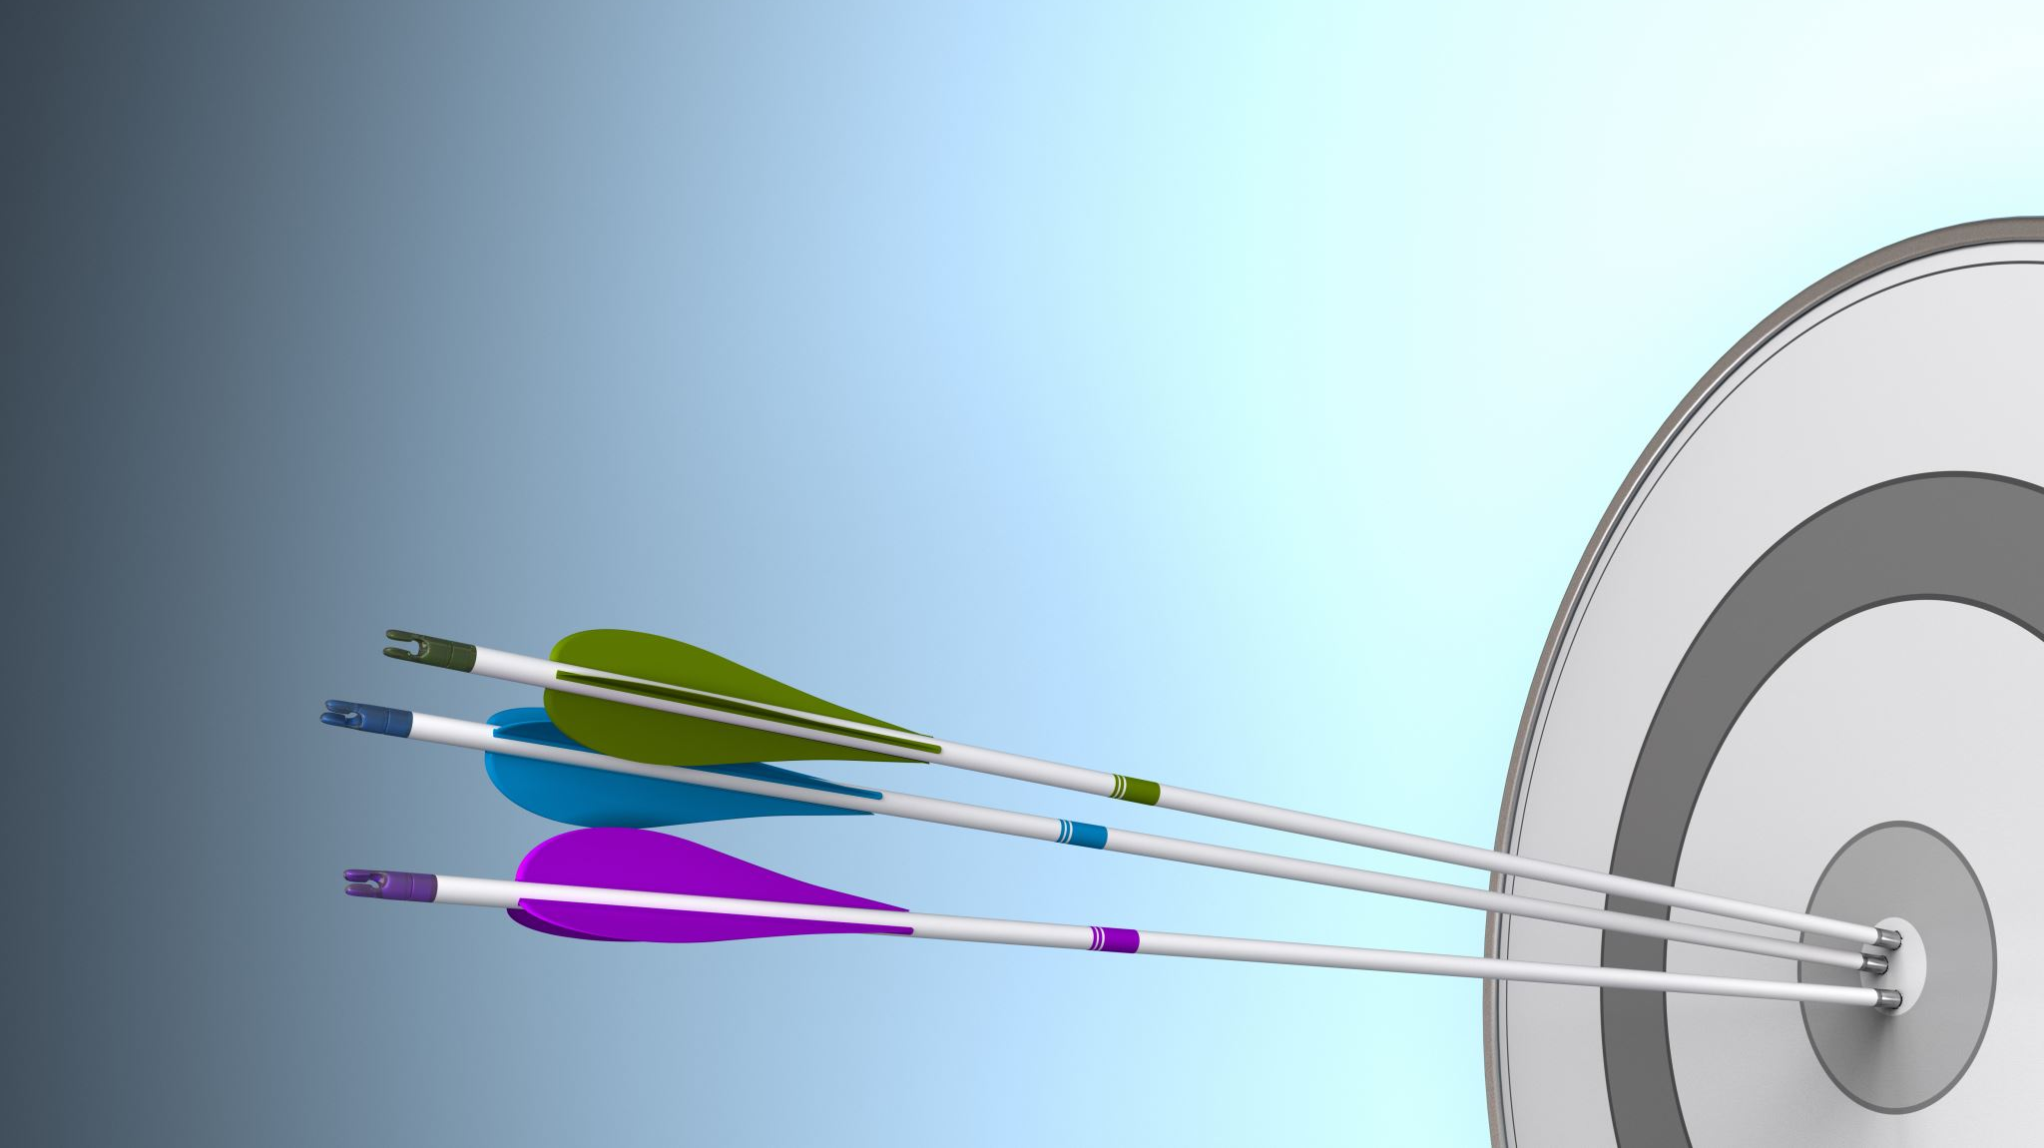
Test Cases
Basic Functionality Test:
Ensured that the models successfully processed input images and produced predictions without errors.
Model Performance Test:
Evaluated accuracy, confusion matrix, and classification report on the test dataset.
Confirmed that the ensemble model outperformed individual models.
Edge Case Tests:
Ambiguous Images: Assessed model performance on images difficult to classify, monitoring confidence levels.
Non-Tumor Images: Tested how models handle images without tumors or unrelated content, expecting correct "No Tumor" classification.
Test Environment:
Used a system with KAGGLE GPU for accelerated model predictions.
Software tools included TensorFlow, Keras, scikit-learn, and custom scripts for preprocessing and testing.

Slide 27

Flask Application
Overview:
Developed a user-friendly Flask-based web application for real-time brain tumor classification.
Features:
Users can upload MRI images and receive immediate predictions.
The application provides confidence scores and flags uncertain predictions for further review.
Demonstration:
Optional: Include screenshots or a short video demo of the application in action.

Slide 28
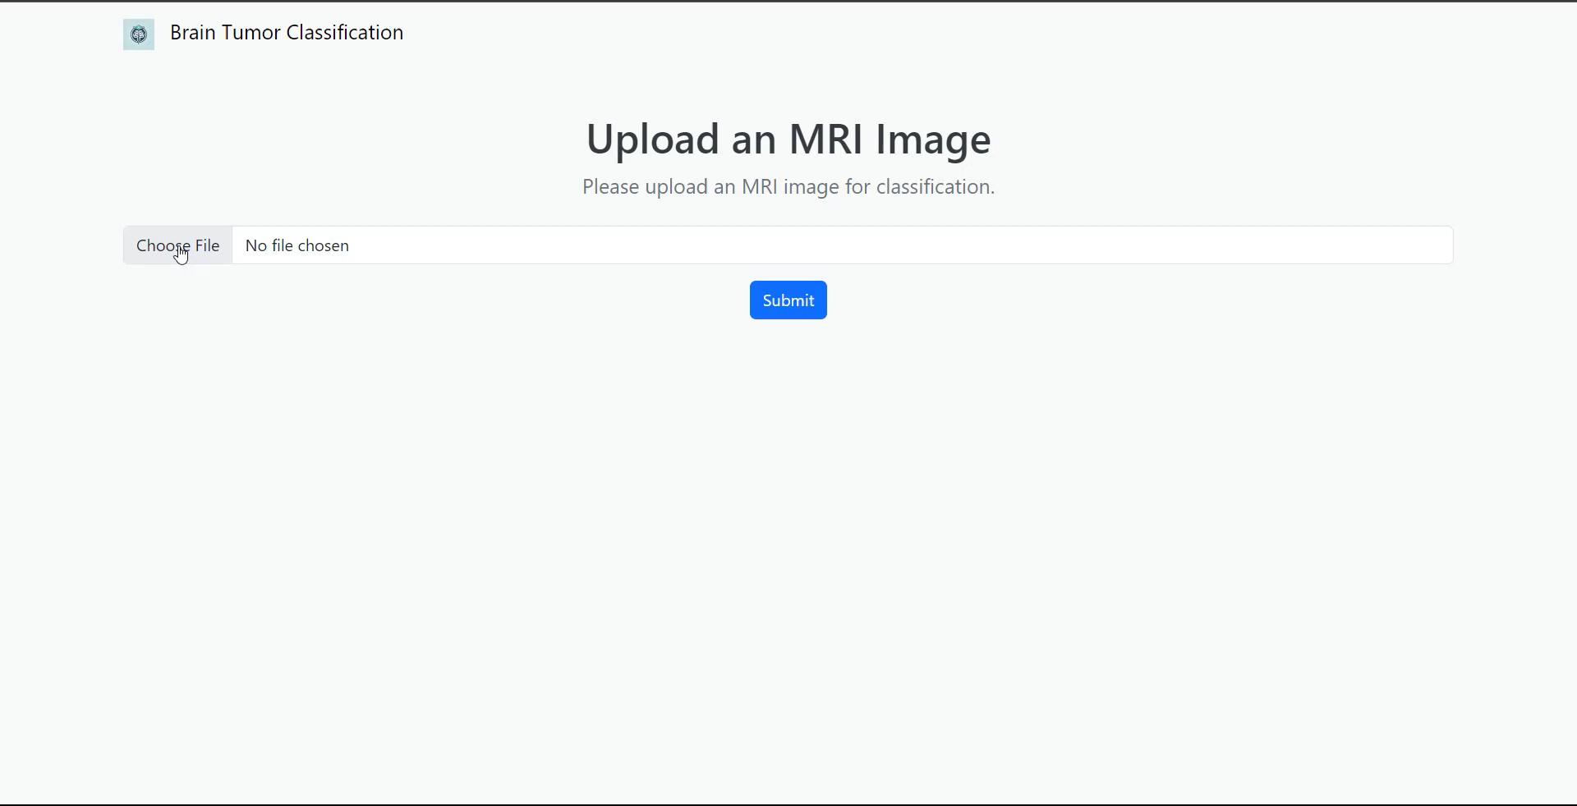
DEMO

Slide 29

Conclusion
Key Findings:
The ensemble model outperformed individual models, achieving higher accuracy and better handling of class imbalances.
Successfully developed a real-time classification application that is both user-friendly and interpretable.
Achievement of Objectives:
Met all project objectives: effective model development, improved classification accuracy, user-friendly application, and ensured model interpretability.

Slide 30
Recommendations for Future Work
Model Improvement: Further work on differentiating between similar tumor types like glioma and meningioma, possibly by experimenting with more advanced architectures like Vision Transformers.
Enhancing Interpretability: Explore additional techniques like Grad-CAM or LIME for more intuitive model explanations.
Real-World Testing: Deploy the application in a clinical setting to gather real-world feedback and refine the model based on actual use cases.

Slide 31
References and Acknowledgments
Textual Sources:
Goodfellow, I., Bengio, Y., & Courville, A. (2016). Deep Learning. MIT Press.
LeCun, Y., Bengio, Y., & Hinton, G. (2015). Deep learning. Nature, 521(7553), 436–444.
Krizhevsky, A., Sutskever, I., & Hinton, G. E. (2012). ImageNet classification with deep convolutional neural networks. Advances in Neural Information Processing Systems.
Software and Tools:
TensorFlow and Keras for model development and training.
Python for data preprocessing and analysis.
Dataset:
Kaggle Dataset: Used for training the CNN model.

Slide 32
Thank You

